Slide 1
AWS
Minor Project-1

Slide 2
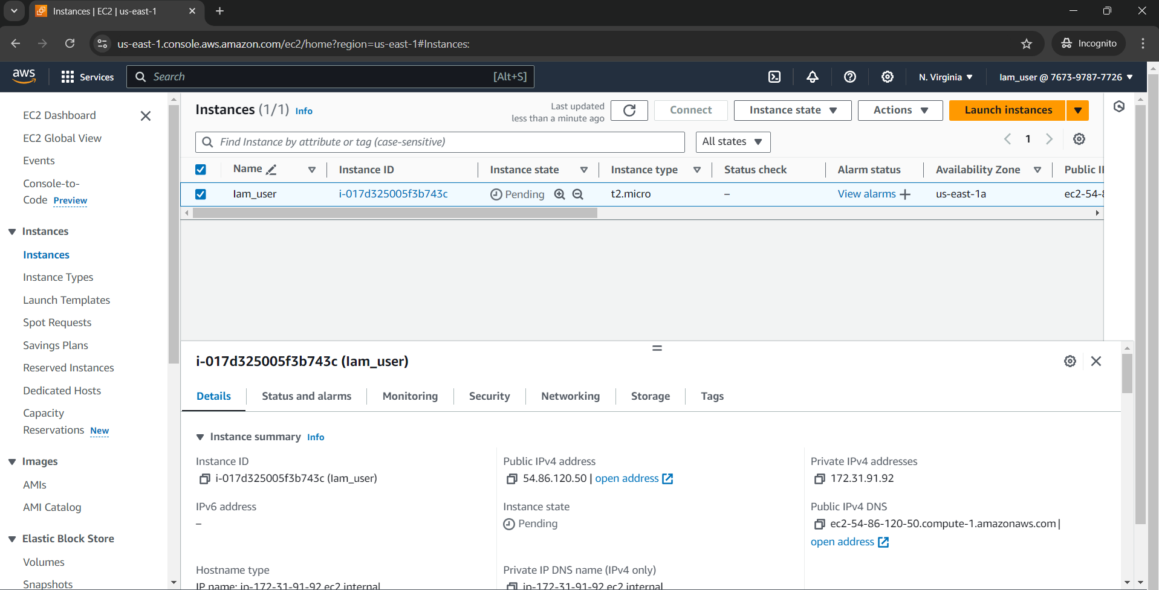
Lab-1-IAM hands on
Setup the MFA for root user
Create a new user with console access and check its default permissions
Assign only ec2 permissions t this user and navigate to diff services with this user acc. Check if u can work with any other services except ec2.
Provide the admin privileges to this user.

Slide 3
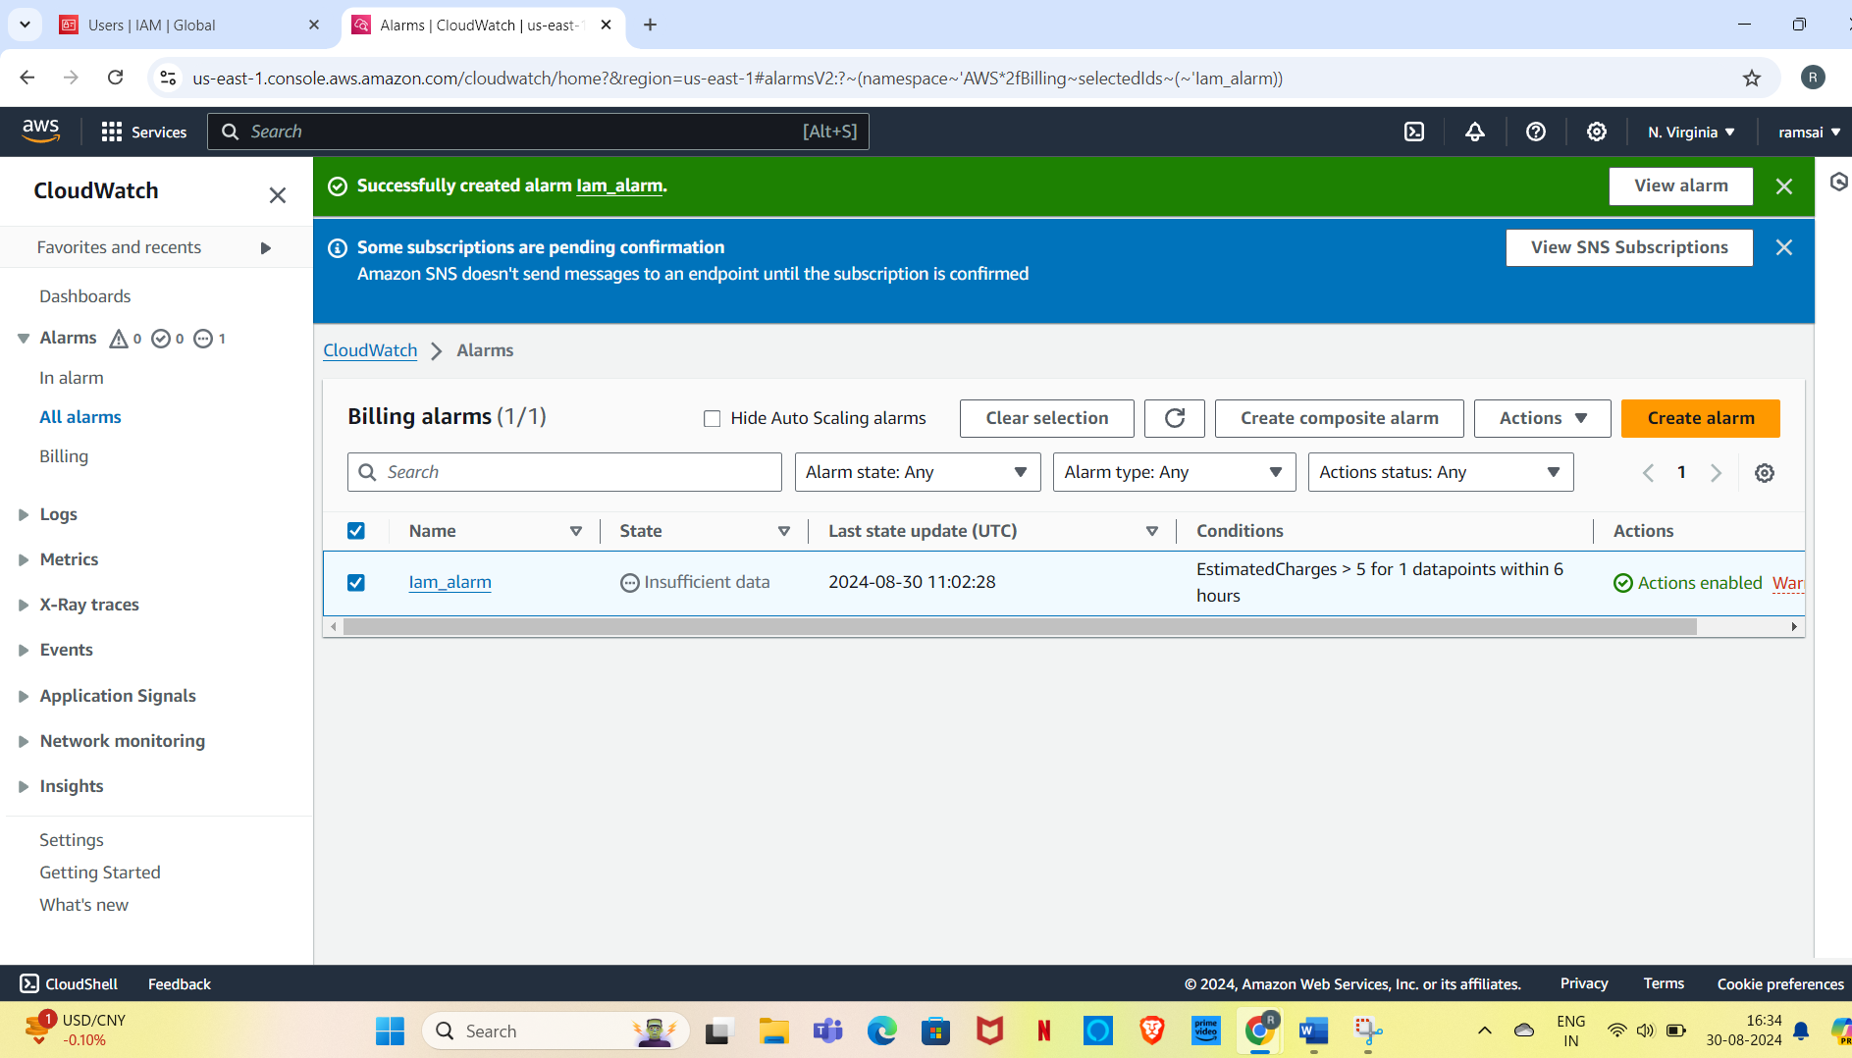
Lab-2-Billing Alarm
Setup the billing alarm for your acc to get a notification whenever you cross the billing threshold.

Slide 4
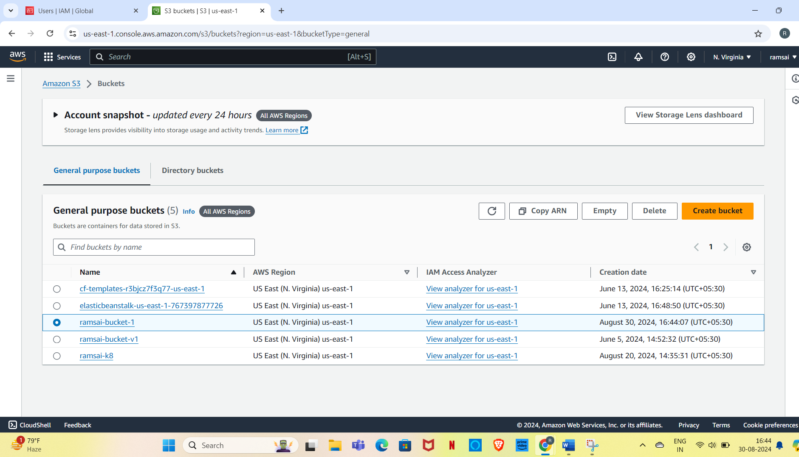
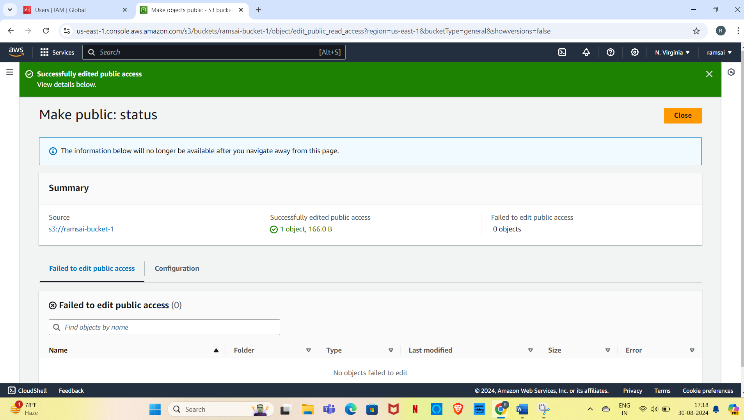
Lab-3-S3 Bucket
Create an s3 bucket make sure to give it a unique name
Upload some test files/folder in the bucket
To access the file over the browser using its url.
It should give error
Check the permissions of the file and the bucket
Make the object public and access it again over the browser

Slide 5
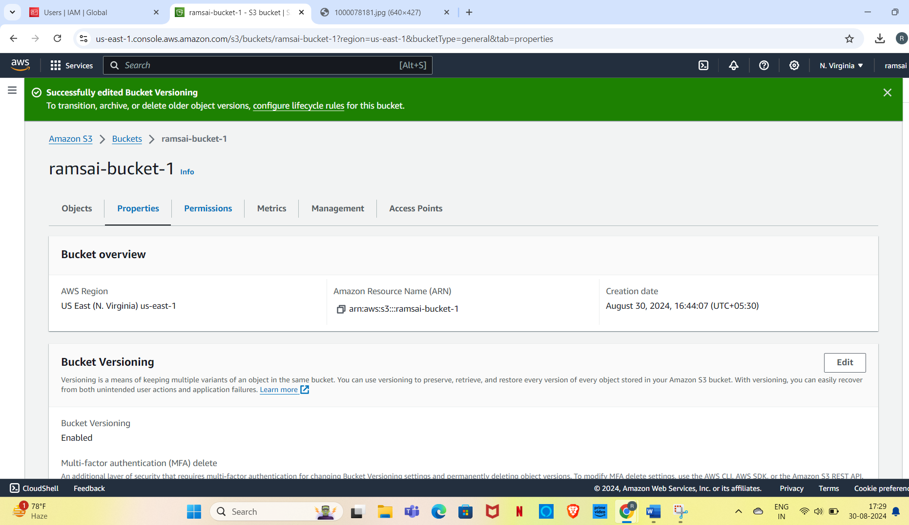
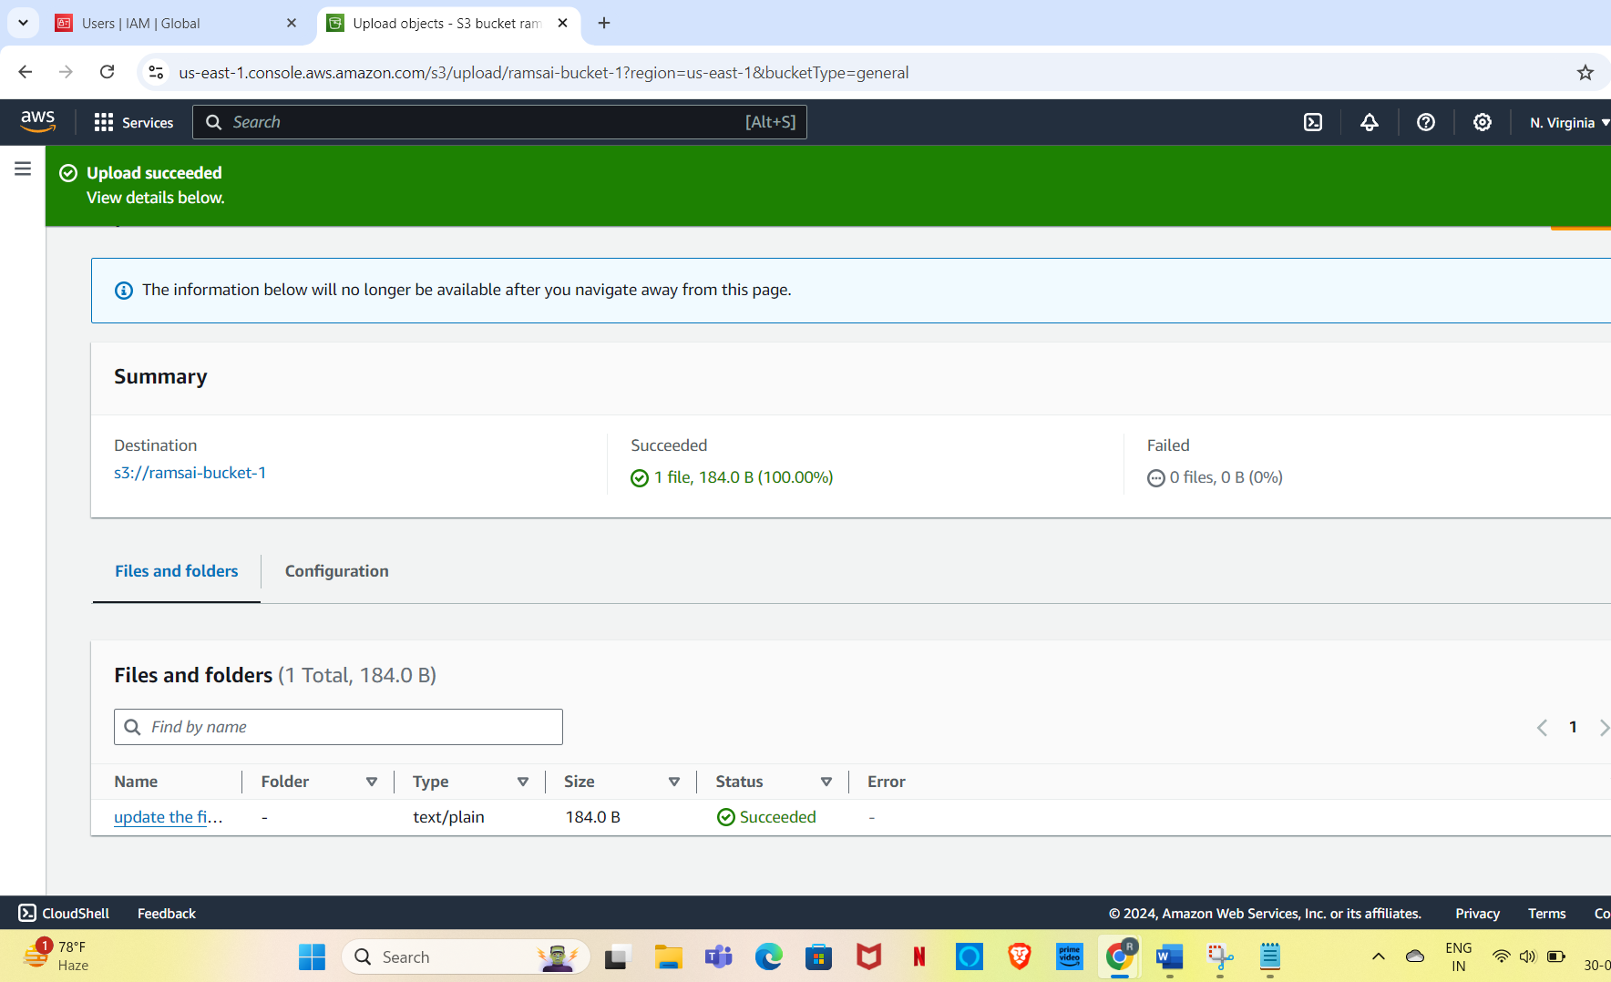
Enable versioning of the object
Create a text file and upload the updated version to the bucket
Check the content of the current file and the previous version of the txt file

Slide 6
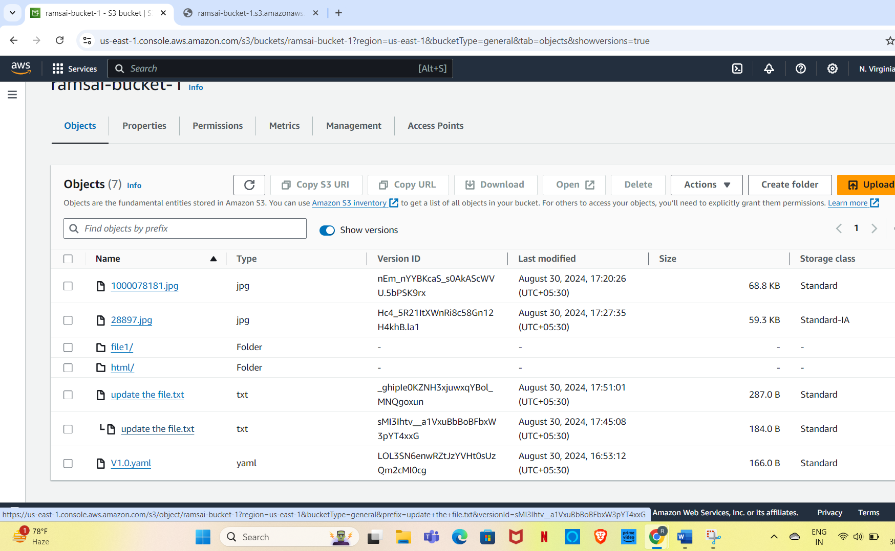
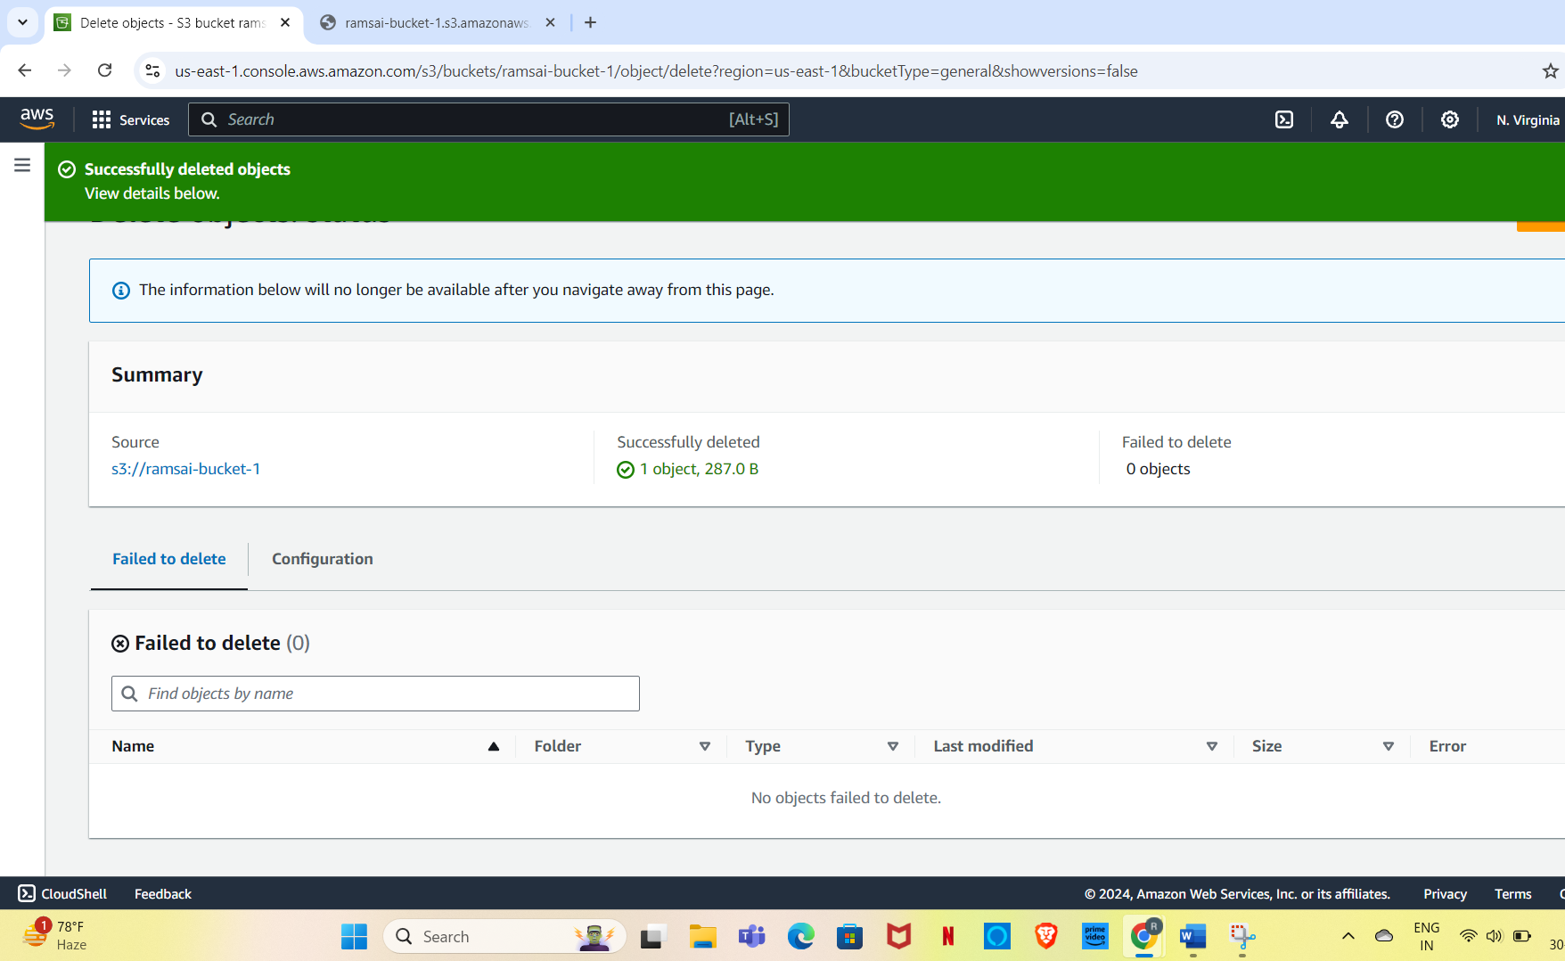
Delete the text file from the bucket
Check the browser the deleted file from the versioning.

Slide 7
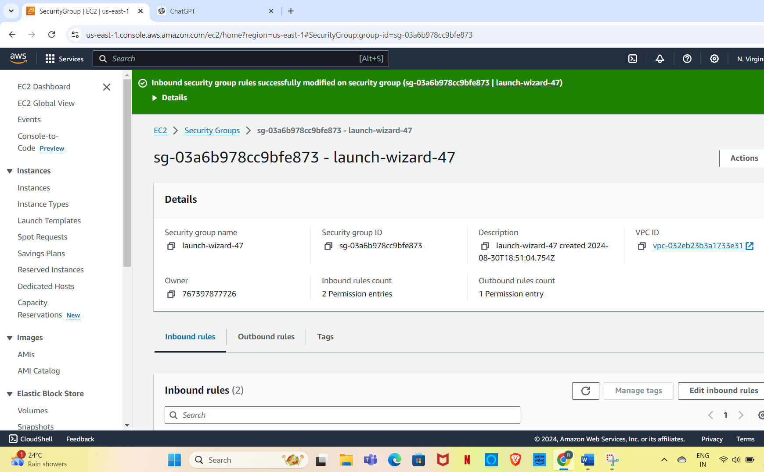
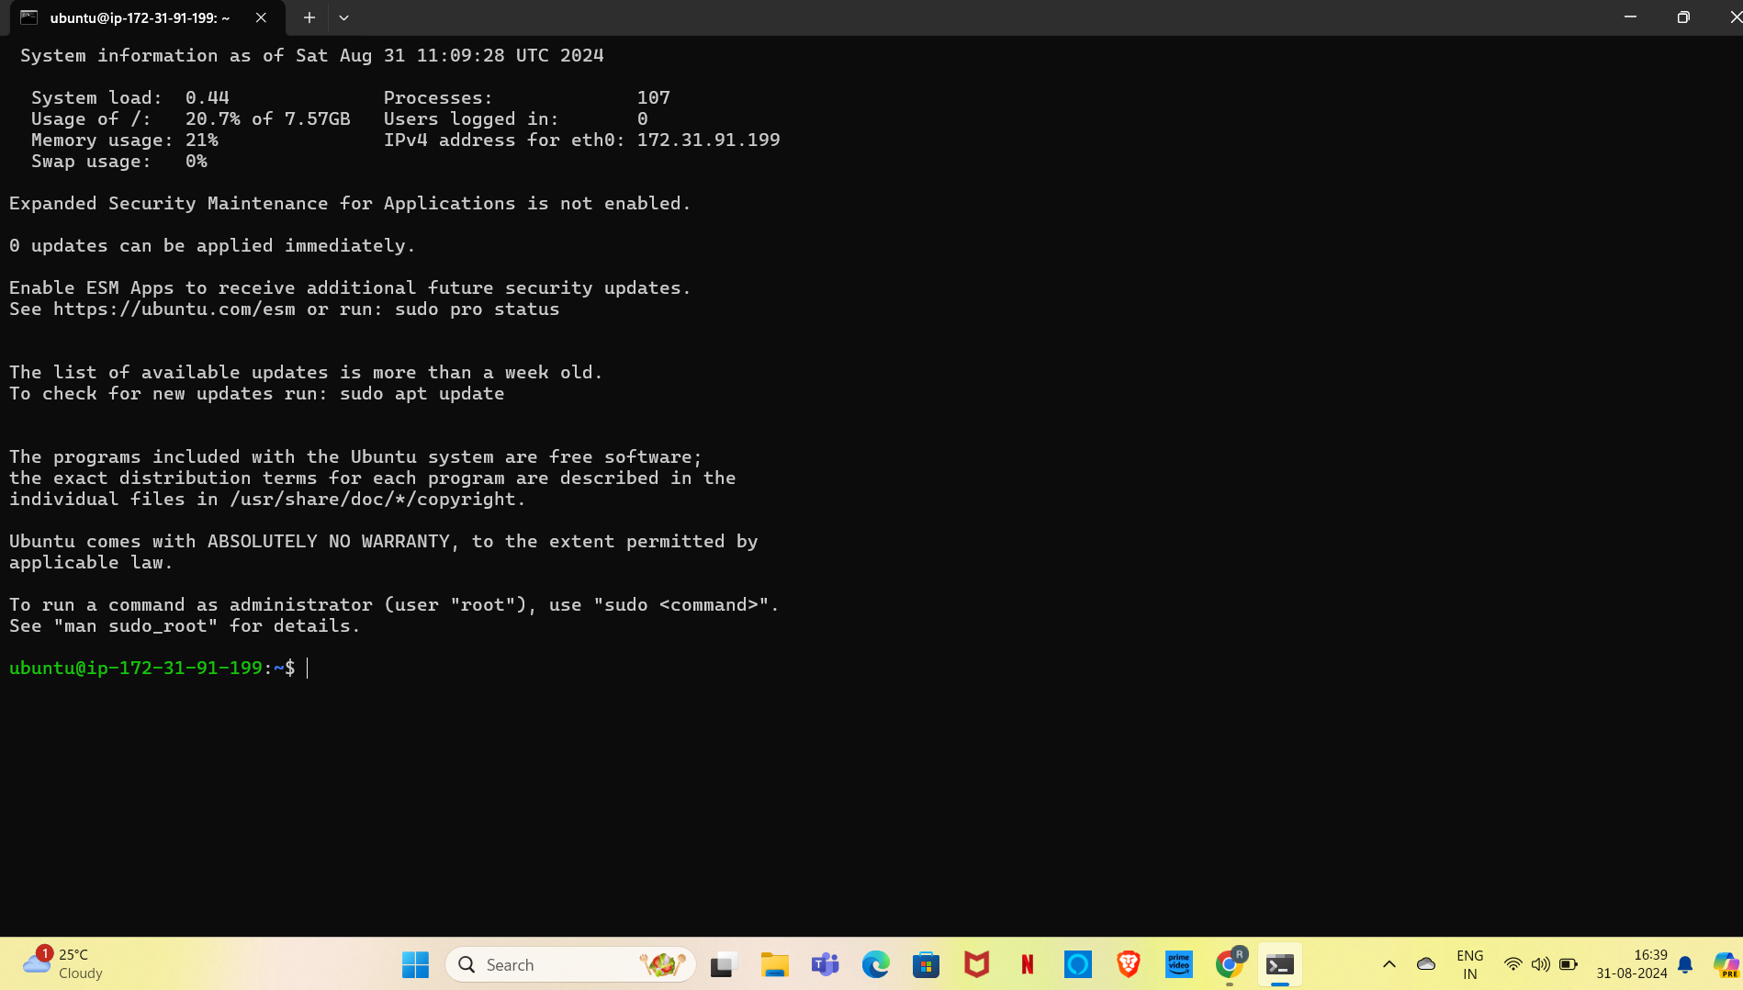
Lab-4-EC2 Instance
Launch the ec-2 instance of the type t2.micro with ubuntu os(free tier)
Allow the required port in the security grps so that you can access it from outside
Access this instance from your machine using putty/other ssh softwares.

Slide 8
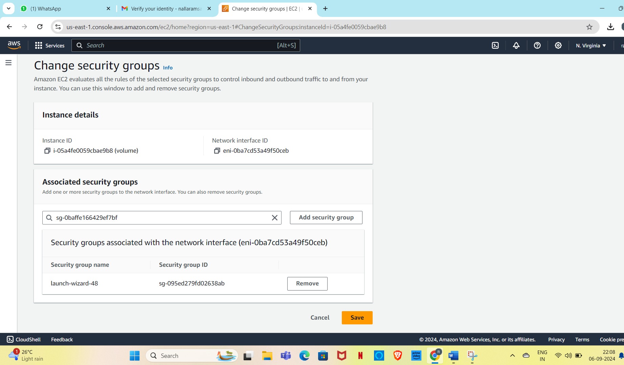
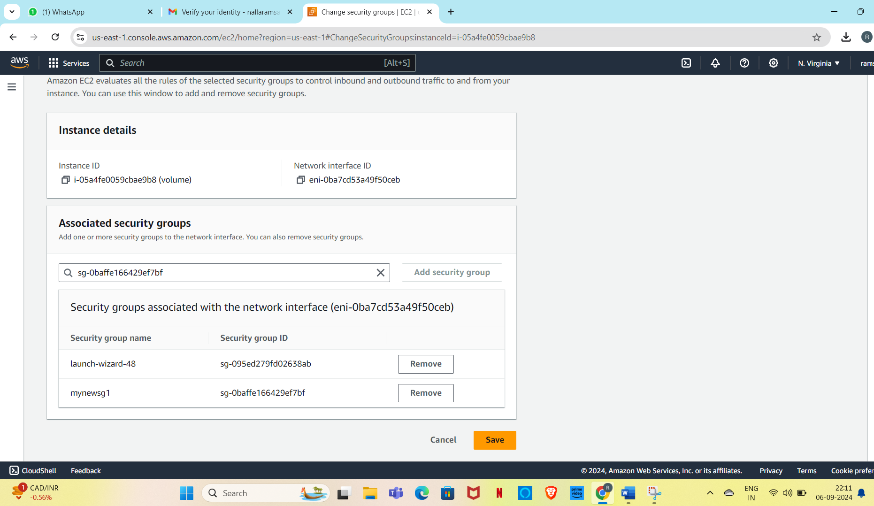
Lab-5-Security Groups
Create a new SG and name it as “mynewsg”
Check the default rules in this SG
Allow inbound port 80 and 22 from your ip address
Select a range (ip/28) so that any changes in your dynamic ip will not impact the rule
Attach this new SG to your existing ec2 instance and try to access the server no(SSH).

Slide 9
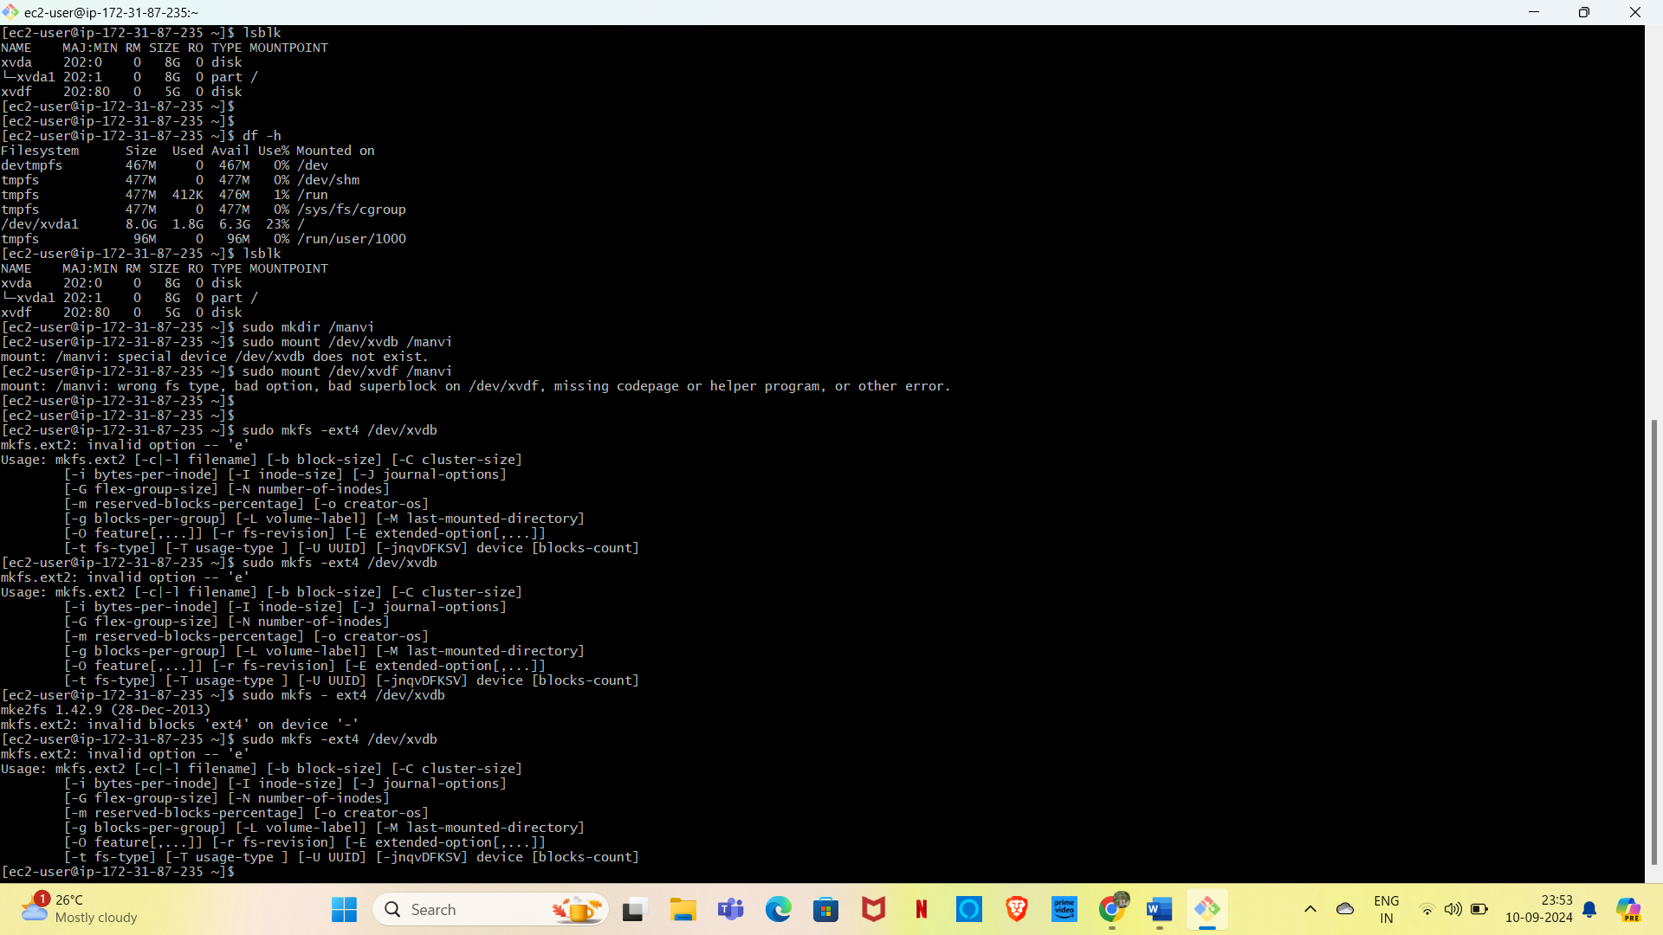
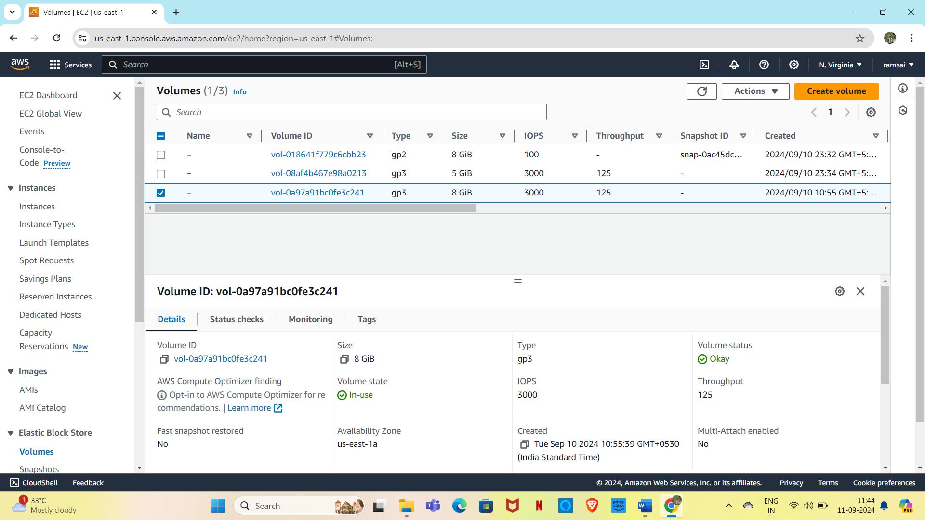
Lab-6-Volumes and Snapshots
Create one 5gb volume and attach it with the running ec2 instance
Increase the size of the this volume it 8gb and check it in the instance
Extend the size of this of this volume inside the linux machine
Take a screen shot of this volume and delete it
Create a new volume with the snapshot and attach it to the server just like the step1.

Slide 10
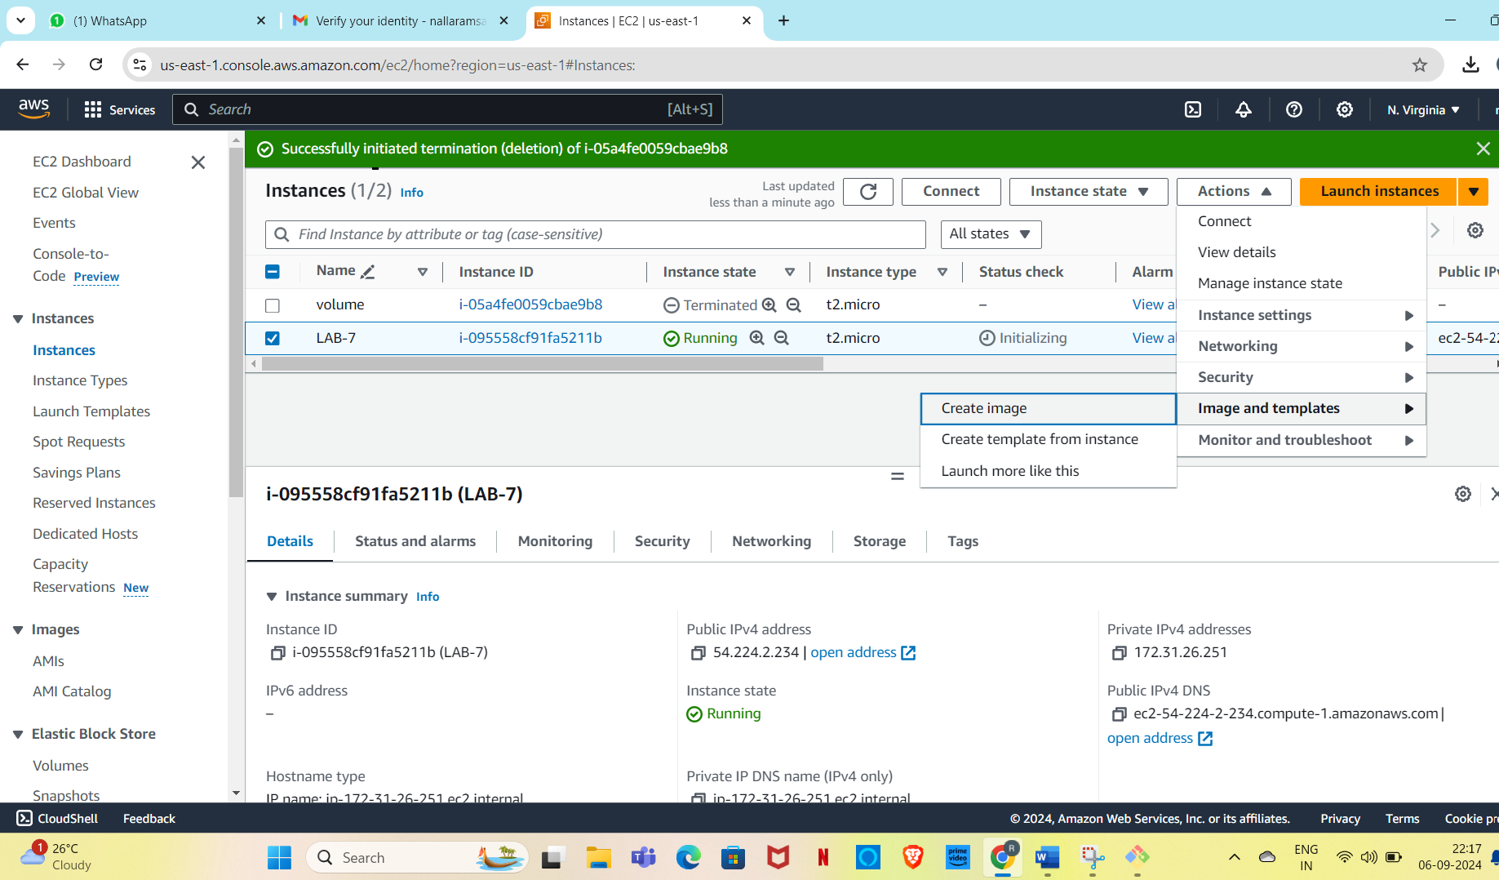
Lab-7-AMIs
Create an AMI of your running instance.

Slide 11
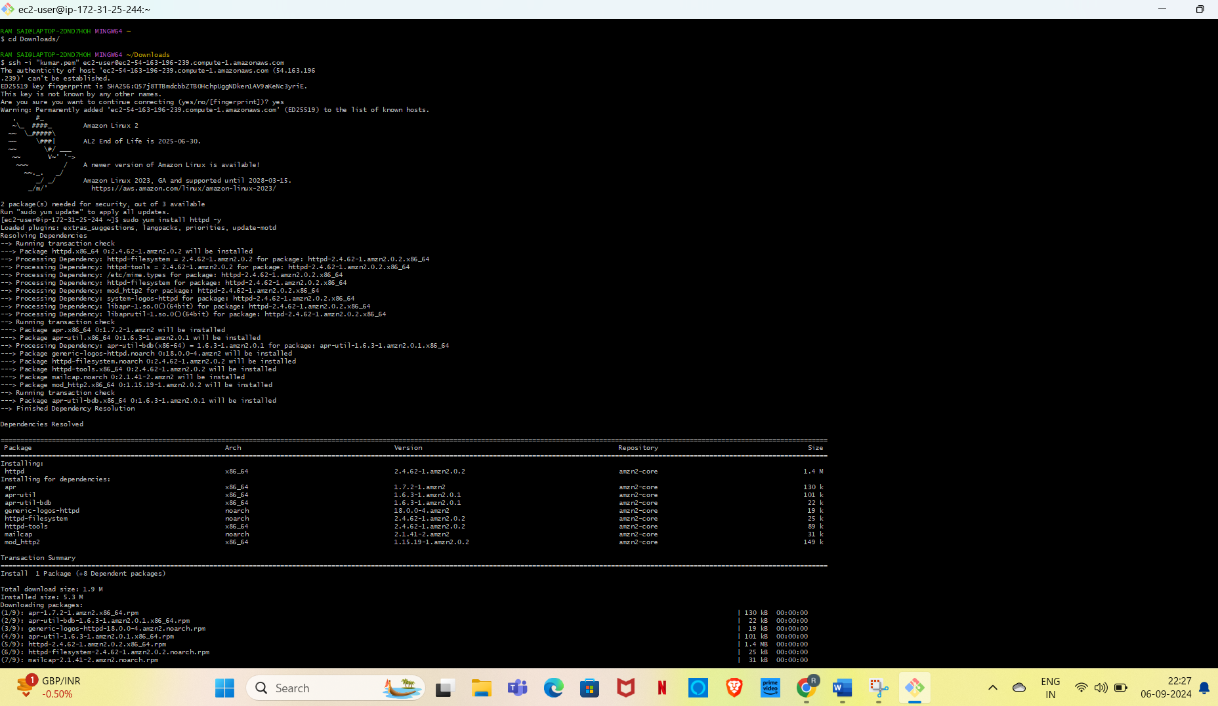
Lab-8-Load Balancers
Create two ec2 instaces and install nginx server on one machine and apache on server 2
Access both the severs over browser and check if their web pageis visible
Create one load balancers(app/classics) and attach both the instances with the load balancers
Allow only port 80 in LB security groups and also make the SG of your instances to receive request from LB only on port 80.

Slide 12
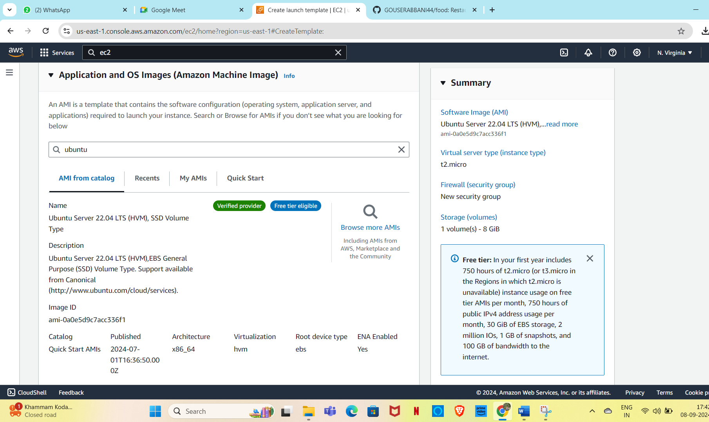
Lab-9-Auto scaling group and LT
Create one launch template with ubuntu server
Create an auto scaling group and attach the above created as
Keep the size of instances as Min = 1 , Max = 3
Try to change the max capacity and see the new instance should get created.

Slide 13
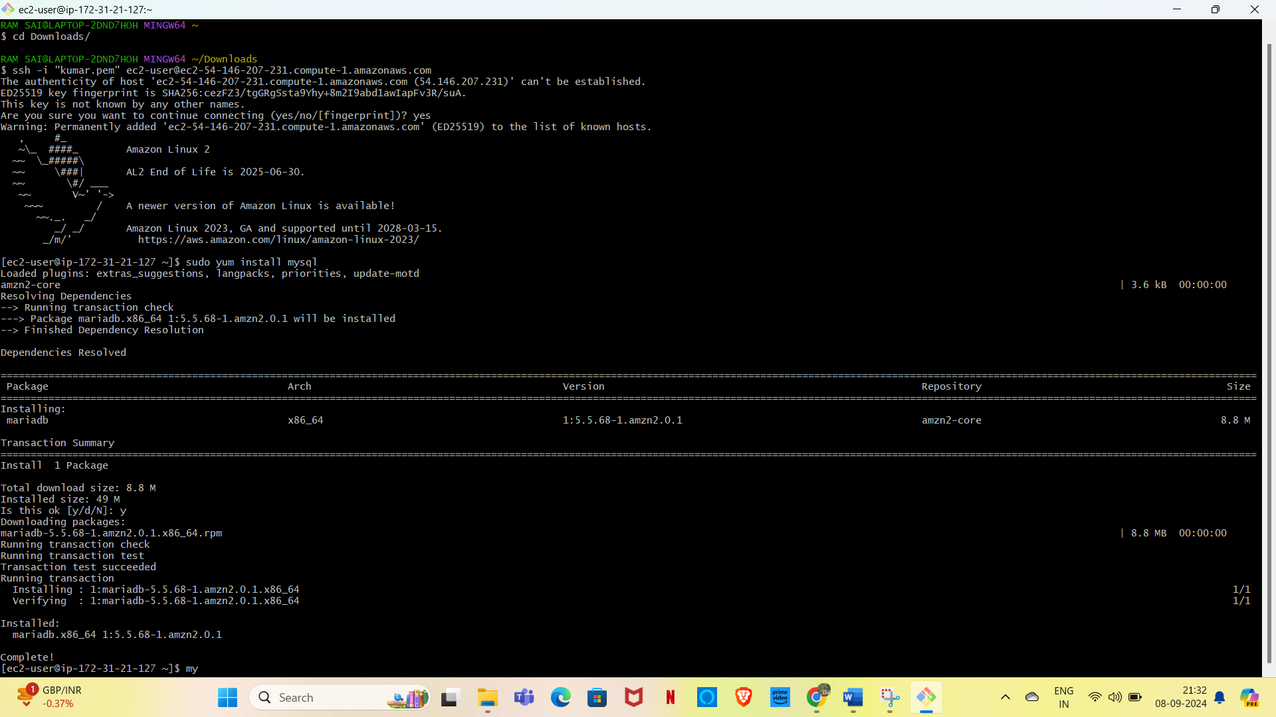
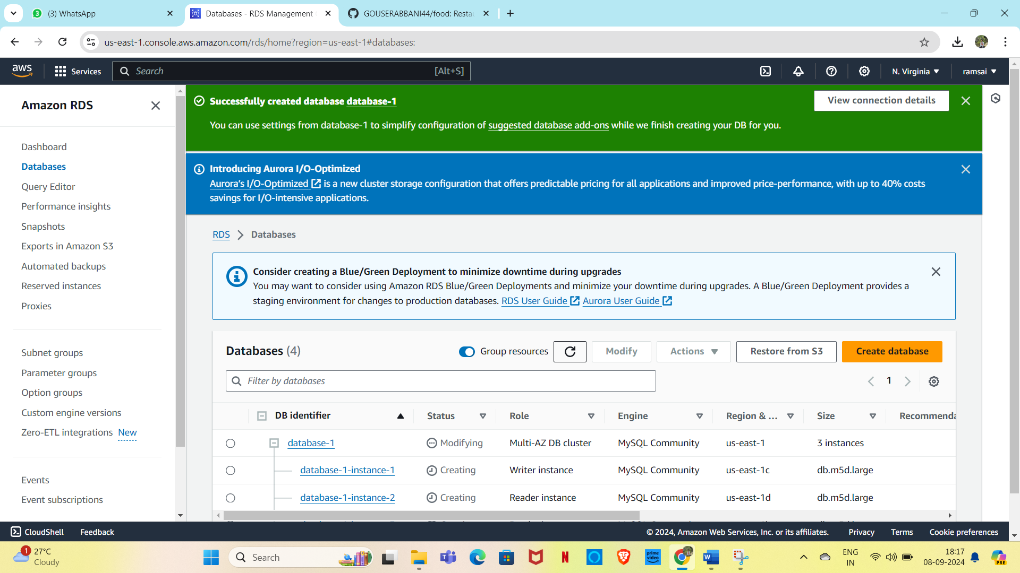
Lab-10-RDS
Provision an RDS instance
Open MySql port in the connected SG
Access this RDS from your EC2 instance.

